Slide 1
Career Assistant Program
(Sprint 3)
By: Calvin Mitchell, Danielle Devose, Nathaniel Washington, and Jeremy Metellus

Slide 2
User stories (Goals)
01
02
03
Project Architecture (Update)
Discussed and decided what architecture we want to organize into (client server vs. layered)
Optimization
Code in Job Postings has been optimized, faster runtime and less code
CI/CD Integration (updated)
Interaged CI testing and planning to integrate E2E testing, refined linters

Slide 3
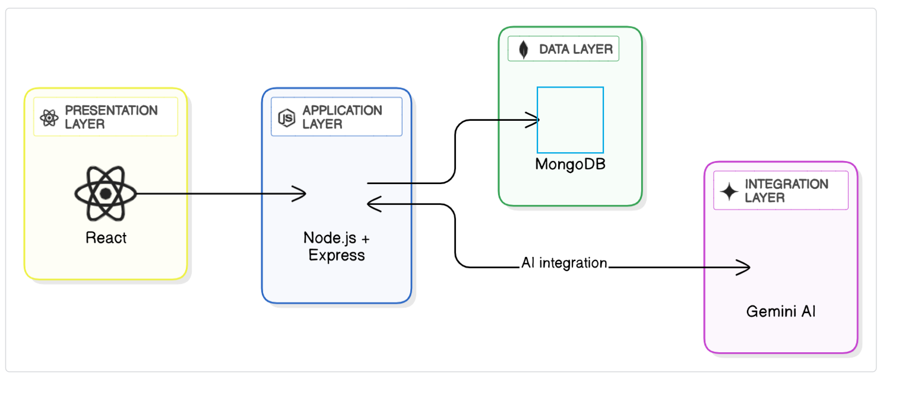
Architecture Snapshot (Before | Sprint 2 )

Slide 4
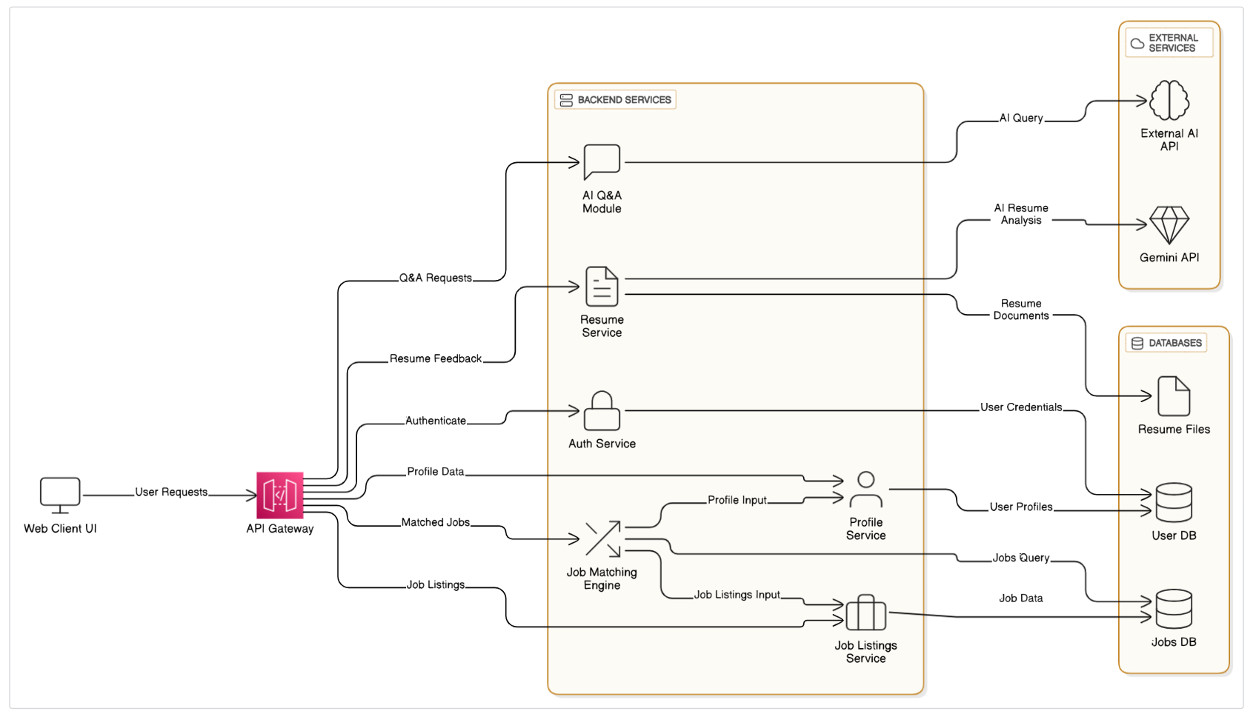
Architecture Snapshot (After | Sprint 3)
Notes:
The system is centered around an API Gateway that routes requests from the web client to modular backend services. Each service handles a specific concern—like authentication, profile management, job listings, resume feedback, and AI Q&A.

Slide 5
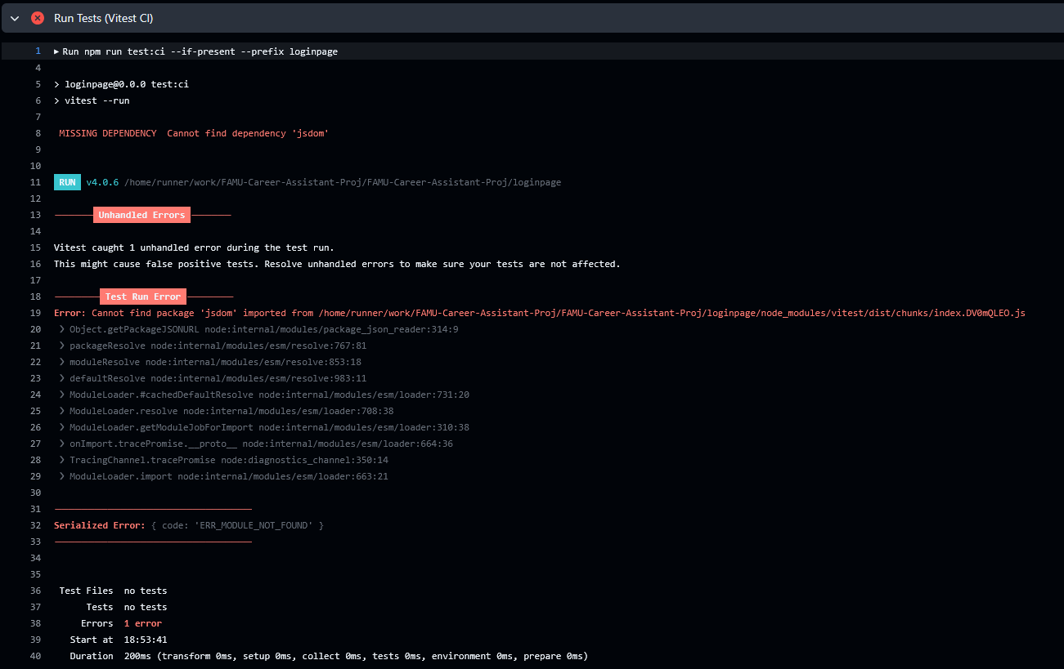
CI/CD Dependencies
node.js.yml - runs the initial frontend setup
Cd loginpage, npm install, etc)
Super-linter.yml - the all project linter, catches secrets file, checks javascript standards, etc
Qodana.yaml - Jetbrains linter (shows all the errors in a pretty GUI)

Slide 6
Links to Demo/Github
Github

Slide 7
Thanks!

